Slide 1

Welcome to the project of Next Hikes for IT Solution
Project name : Data Harmonization and Insights Extraction. FROM : AMAN SHARMA

Slide 2
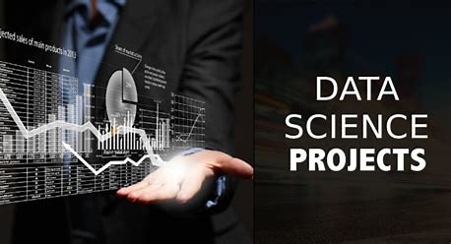

Slide 3

Data Harmonization and Visualization
VFVFFDD
Data harmonization combines and standardizes data from various sources. It arranges elements, definitions, and formats for consistency across datasets. This method makes analysis and insight generation more efficient.
Data visualization is the graphical representation of information and data. By using visual elements like charts, graphs, and maps, data visualization tools provide an accessible way to see and understand trends, outliers, and patterns in data.

Slide 4
PROJECT OVERVIEW Analysis Statement Solving Statement
We have a given task of multiple dataset. As a role of junior data scientist. Therefore, such that we read all the data analysis and searching . and but I analysis this data after that I have found any rentals of riding data. But it could be daily records of details as well as date, season, holiday, temp. and weather situation and so on.
After Analysis all the data then I facing some problem that how to solving the data . So, all the data cleaning with the help all python library . Resolving and cleaning all the analysis report with observation and insights a comprehensive Jupiter notebook with coding visualizations of the data and merged them .

Slide 5

Dataset Attributes information
Dataset 1 The dataset 1 records the details of bike rental data with the help of date , season , holiday, working day, weather situation given all information with the help of temperature, humidity , windspeed.
Dataset 2 The dataset 2 is find out some null values. In a temperature for This potentially different in the dataset 1 . So we can create median values and put them.
Dataset 3 The dataset 3 we will observed that some interaction the data of merging the data1 and data 2. so it include additional information for graphically used for duration for temp. and humudity.

Slide 6
Tools and Techniques Tools 1. Pandas for data manipulation. 2. NumPy for numerical computations. 3. Matplotlib for graphically presentation. 4. Seaborn for advance of visualization process.
Techniques Merging datasets. Imputation of missing values. Outlier detection and handling. Data validation and exploration.

Slide 7
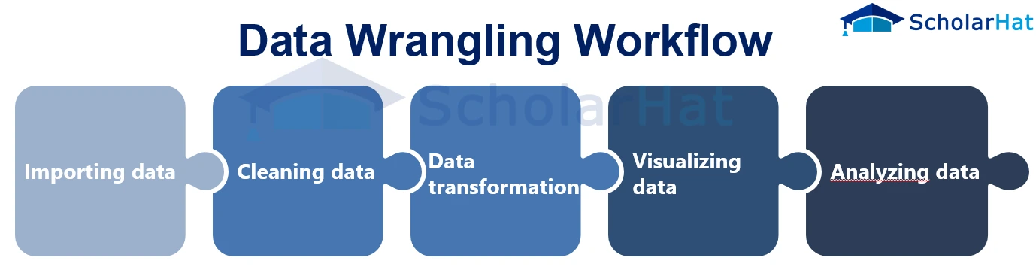

f
Task 1 : Combining datasets
Firstly, the dataset 1 and dataset 2 Integration after cleaning all the both data. With the help some function like : drop values, duplicates values, null values, info etc. Data merging with the help of some statistical techniques combining data from multiple sources, often disparate or heterogeneous, into a single, unified dataset. Identify all the missing values for combining dataset using perform basic statistical analysis to evaluate the Central tendency (mean , median, mode) to filling all the missing values. And cleaning the data form of visualization and analysis od data.
Task 2 : Handling Missing Values

Slide 8
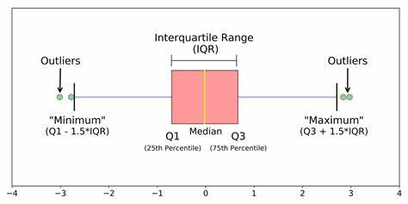
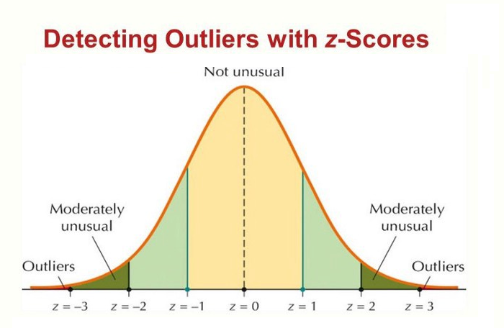
Data Wrangling : Outlier Detection and Handling
Detection of Outlier Process outlier deviation significantly from norm, can distort Measure of central tendency and affect statistical analyses. Utilize statistical method like scatter, dist plot, line plot. With the help IQR and Z-scores to detect the data. Data Handling Process To find all the missing values in all the combining dataset by using some statistic technique like mean , median ,mode etc. and after that filling the values in the dataset. And merged all the data. And after that no outlier find after caping function used.

Slide 9
Graphically Represent

Slide 10
Visualization Techniques
A box plot is a graphical representation of statistical data based on the minimum, first quartile, median, third quartile, and maximum. Heatmap data visualization is a powerful tool used to represent numerical data graphically, where values are depicted using colors. This method is particularly effective for identifying patterns, trends, and anomalies within large datasets. A scatter chart shows the relationship between two different variables and it can reveal the distribution trends. A bar graph can be defined as a graphical representation of data, quantities, or numbers using bars or strips. They are used to compare and contrast different types of data, frequencies, or other measures of distinct categories of data.
BOX PLOT GRAPH
HEAT MAP GRAPH
SCATTER GRAPH
BAR GRAPH

Slide 11
.
CONCLUSION !
Here , this project is very interesting on topic of data harmonization and insights extraction. In this project I have found values extraction , cleaning , merging and graphically representing. So, I would like to share my experience with this project .so how to working on missing data . As well as more skill developed and research. It will be more helpful for IT Industry THANKS FOR NEXT HIKES IT SOLUTION FOR GIVEN THIS PROJECT

Slide 12
THANK YOU

